Slide 1
AL RAMI
Aluminum & Glass
Prequalification Manual

Slide 2
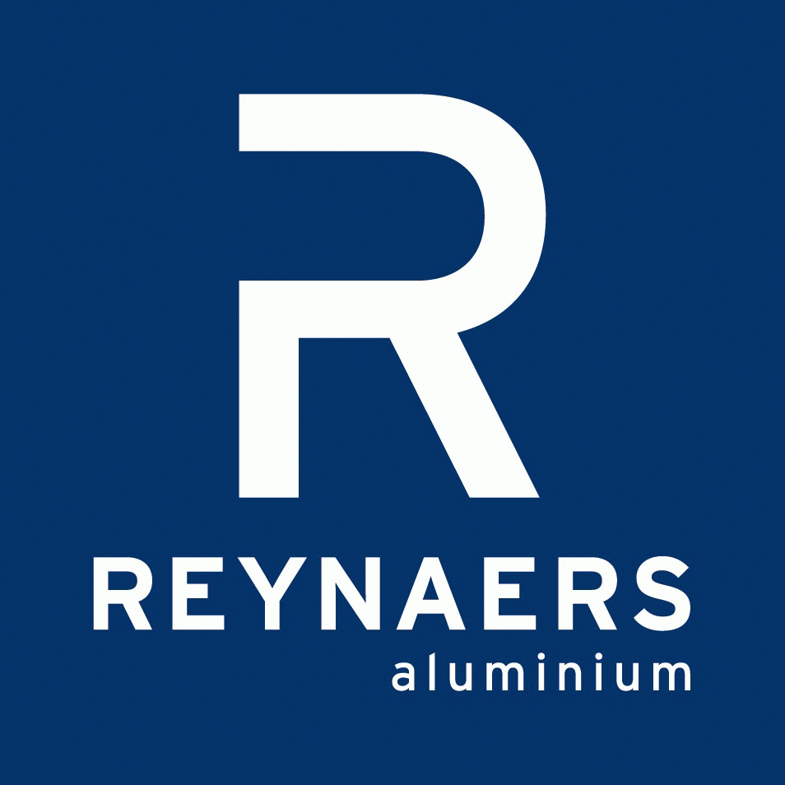
Company Background
Founded in 1992, Al Rami Aluminum & Glass est., part of Al Rami Group, operates from Al Ain, Abu Dhabi emirate's second city.
Al Rami Aluminum & Glass Est. provides all types of aluminum-related products and services: from designing and fabricating, to installing aluminum facades, windows and doors. All of our work is compatible with the different aluminum architectural systems and products in the market. Our commitment to timely delivery and superior products and systems has made us one of the leading aluminum fabricators and manufacturers in the regional market.
Our latest partnership with Reynaers Middle East, one of the world's most renowned aluminum system providers, reflects our credibility in the fabrication of aluminum architectural systems. Currently, Al Rami Aluminum & Glass Est. is the UAE's Exclusive Authorized Fabricator for selling and fabricating the internationally tested and accredited Belgian system- Reynaers Aluminum.

Slide 3
Competencies
Overview
Al Rami Aluminum and Glass products are used on a wide range of applications, including high, mid, and low-rise buildings, as well as other facilities. Our expertise in producing various sophisticated standard and custom facades is unparalleled. Moreover, we bundle our products with lifelong maintenance services after the installation, and we are highly recognized for being quick in responding to and servicing our clientele. At Al Rami Group, we always ensure that we meet deadlines without jeopardizing the level of quality in our fabricated products.

Slide 4
Challenging Time while Maintaining Quality
Al Rami Aluminum & Glass est. faces today's complex business environment by combining experience with continuous improvements and developments, which adds flexibility as a quality to our competencies. We are committed to responding immediately to our customers' requirements, with emphasis on providing A-Z support about any product or service provided by our allies in the market. As we renew and re-engineer our capabilities, we maintain our focus on crucial factors such as quality, reliability, innovation and most importantly, customer satisfaction.
Al Rami Aluminum & Glass est. partners with its clients with the aim of understanding their specific needs, which in turn helps us to benefit them beyond the provision of tangible goods. By listening, sharing and proposing solutions to our partners, our role extends to offering services that encompass a built-in consultative approach. On the other hand, we are committed to fabricating innovative and different aluminum products of diverse designs.
Fundamentally, our aluminum fabrics consist of products that meet the highest engineering and technical standards, which make our final products ideal for today and tomorrow.

Slide 5
Our Manpower
Al Rami Aluminum & Glass takes pride in its employees and their knowledge of fabricating and applying different aluminum systems. Likewise, the application of their technical insights onto challenging projects is unrivaled.
We strive to supply quality human resources and workmanship that is competent enough to complete projects of any size. Currently, we employ around 55 skilled field personnel, and therefore, we have the capacity to complete relatively large-scale projects in short periods of time. We can also help you continue "business as usual" by pursuing our work on evenings, nighttime, or weekends, depending on what your situation demands.

Slide 6
Our team presently consists of the following:
Administration Department:
  Managing Director
  Administration Manager
  Public Relations Manager'
  Project Manager
  Personnel Administration Manager
  Legal Representative
  Engineer
  Accountant
  Purchasing Officer

Slide 7
In-House Team: Comprises personnel who are responsible for performing ongoing work indoors, where each team member is an active participant in the fabrication process. By utilizing a specialized input of skills, our in-house teams ensures that high quality products are provided and services implemented within the process time frame.
Outdoor Team: Our outdoor teams are categorized according to different projects, where each team is responsible of the installation of aluminum fabricated products, in addition to the glazing. However, when an urgent need arises for accomplishing a short-time framed project, the demand of manpower is immediately met through the Mission Employment Visa. This solution makes us flexible in increasing the capacity of the team members on site, as per the size and requirements of each project.

Slide 8
Business Partners
Throughout 17 years of operation, Al Rami Aluminum & Glass Est. has established longstanding relationships with leading suppliers from the Aluminum and Glazing industries, both within the UAE and worldwide.
Our partnerships are built on trust, quality, durability, efficiency and on-time delivery; resulting in the highest quality of aluminum products and services that continuously meet our clients' requirements.

Slide 9
Contact Details
& Location Map
For more information about Al Rami Aluminum & Glass Est. products and services,
please contact:
Al Rami Aluminum & Glass Est.
Senaeya Sector
P.O. Box 19982
Al Ain, Emirate of Abu Dhabi
United Arab Emirates
Tel: +9713 72 11 741
Fax: +9713 72 11 740
Mobile: +97150 44 83 004
Email: alrami.group@gmail.com
or aluminum@alrami-group.com

